Slide 1
ENGG104 Electrical Systems
Introductory Circuit Analysis, Boylestad, 12th Ed
Lecture 11
Attribution Nidhal Abdulaziz

Slide 2
Series and Parallel AC Circuits
Chapter 15 – Boylestad
Impedance and phasor diagrams

Slide 3
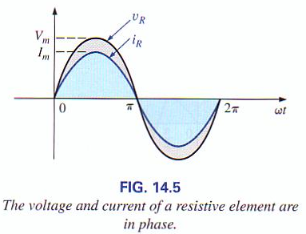



Impedance and Phasor Diagrams
Resistor
V
Boylestad, Prentice Hall 2007
I
Voltage and current are in phase

Slide 4
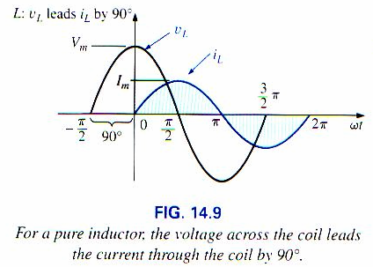
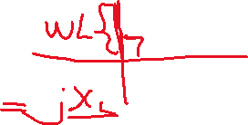







Impedance and Phasor Diagrams
Inductor
V
Boylestad, Prentice Hall 2007
90⁰
I
Current lags the voltage by 90 degrees

Slide 5
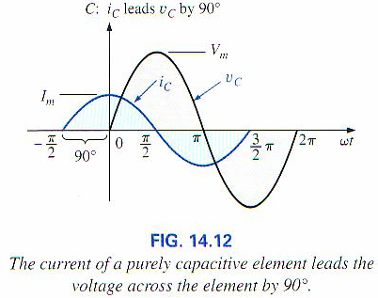

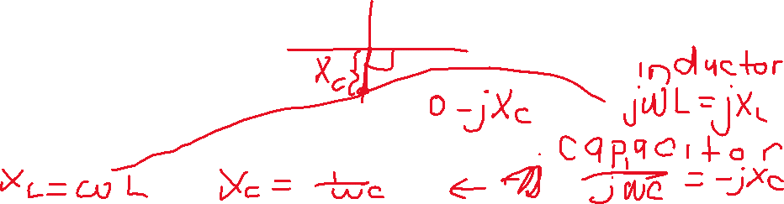
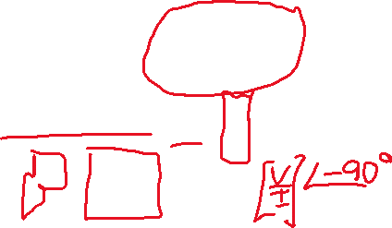
Impedance and Phasor Diagrams
Capacitor
I
Boylestad, Prentice Hall 2007
90⁰
V
Current leads the voltage by 90 degrees

Slide 6
Impedance and Phasor Diagrams
An important note on phasor diagrams:
Any phasor diagram can be rotated in either direction as long as the relative phase angles (and the magnitudes) of the various phasors are maintained. For example, for the capacitor following can be done.
I
I
V
90⁰
90⁰
V
90⁰
I
V

Slide 7
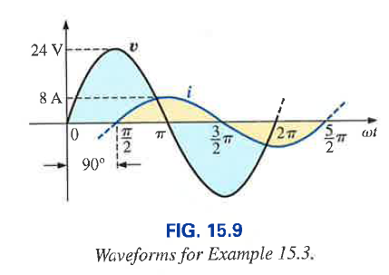
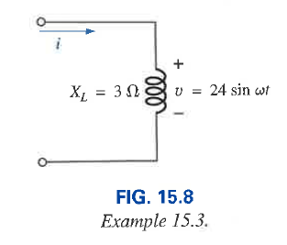
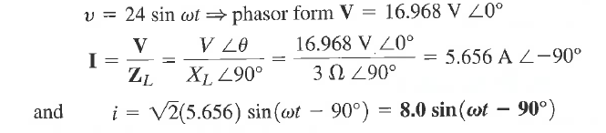









Example 1

Slide 8
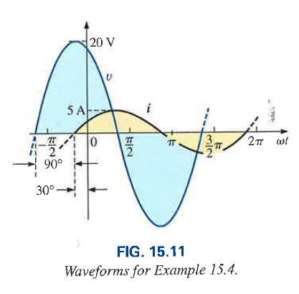
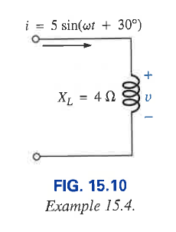
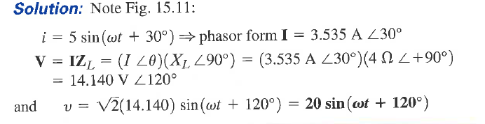




Example 2
Phasor: write the magnitude
In rms value
Conventional: write the magnitude in peak value

Slide 9
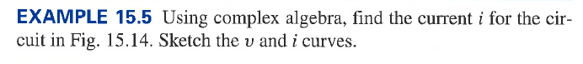
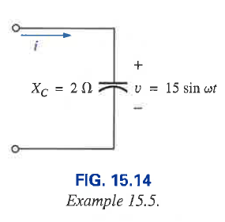
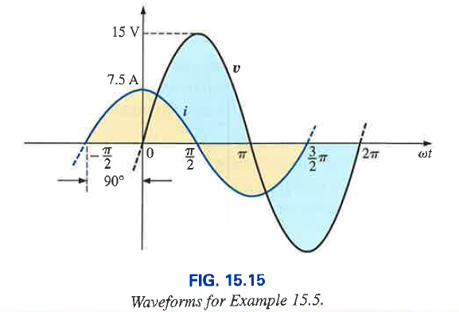
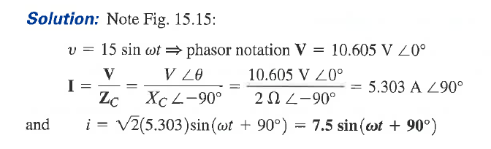
Example 3

Slide 10

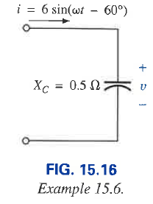
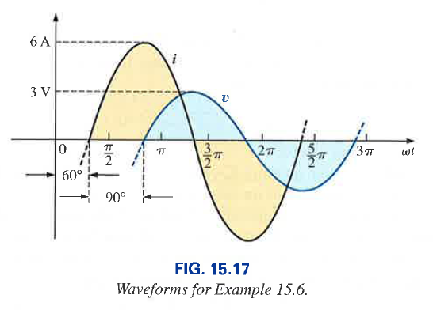
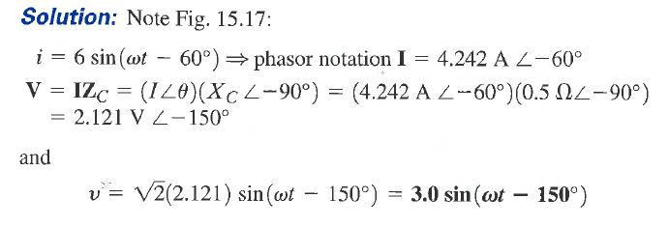
Example 4

Slide 11
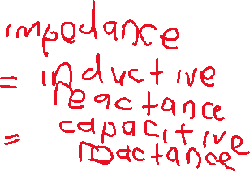



Series Connection of Impedances
Resistors, inductors and capacitors can be connected in series to form complex circuits. Since each component can be represented as an impedance, we can draw the following circuit:
Z₁
Z₂
Z₃
Total impedance = Z_{T} = Z₁ + Z₂ + Z₃
Z₁ = R,
Z₂= jωL,
Z₃ = 1/jωC

Slide 12

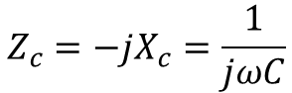
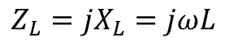
Series Connection of Impedances
R
jωL
1/jωC
Z_{T}
$$Z_{L}=jX_{L}=jωL$$
$$Z_{c}=−jX_{c}=\frac{1}{jωC}$$
For a series connection of R, L and C
Total impedance = Z_{T} = R + jωL+1/jωC =R + jX_{L} - jX_{C}
jX_{L}
-jX_{C}
jX_{L}
Z_{T}
R
R
-jX_{C}
Impedance diagram

Slide 13
Series Connection of Impedances
V_{R}
V_{R}
V_{R}
V_{L}
V_{C}
R
jωL
1/jωC
V_{T}
I
Supply voltage = V_{T} = V_{R} + V_{L} + V_{C} = IR + I(jX_{L}) + I(- jX_{C})
I(-jX_{C})
− angle between voltage current (power factor angle of the total circuit)
I has been selected to be the reference
I(jX_{L})
V_{T}
θ
I
IR

Slide 14
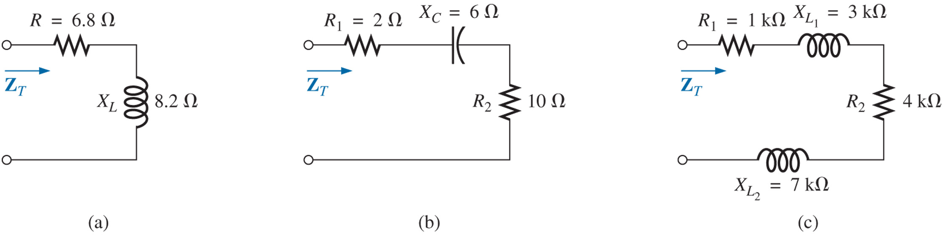
Example 5: Series Connection of Impedances

Slide 15
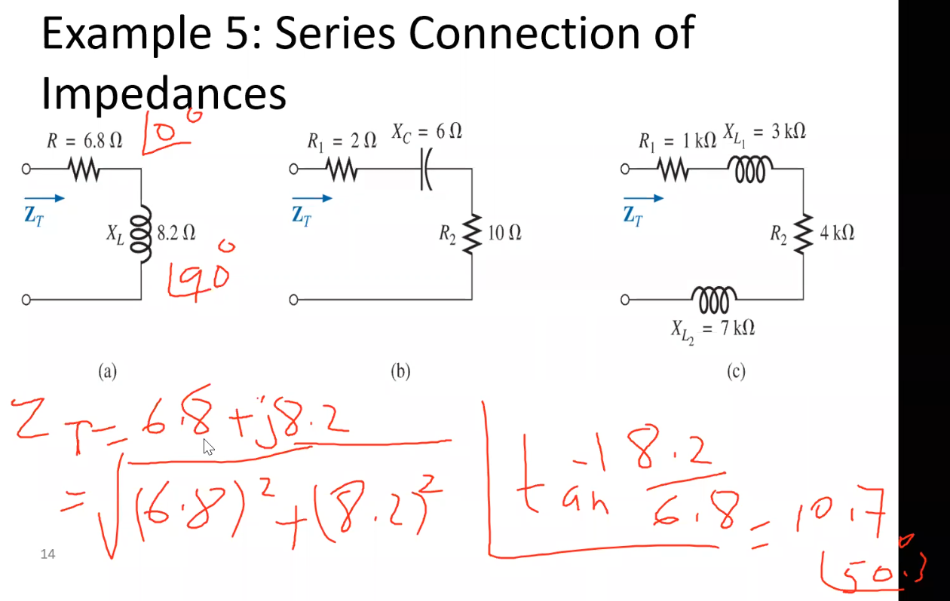


Magnitude?
Phase?

Slide 16
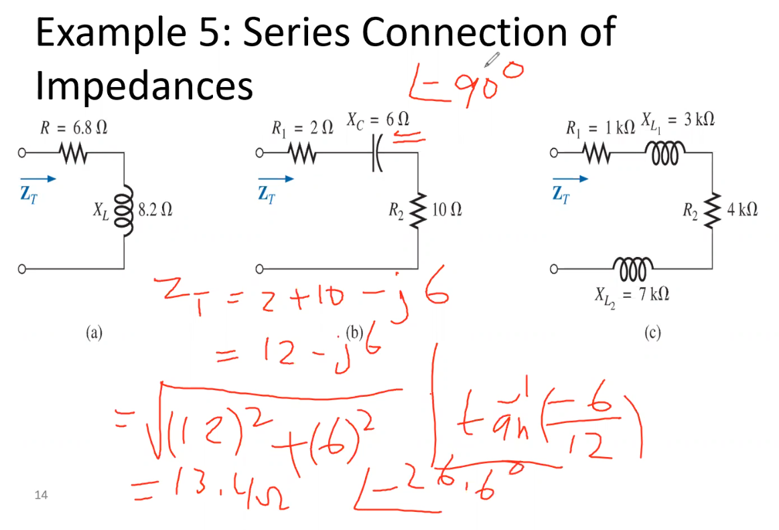

Slide 17
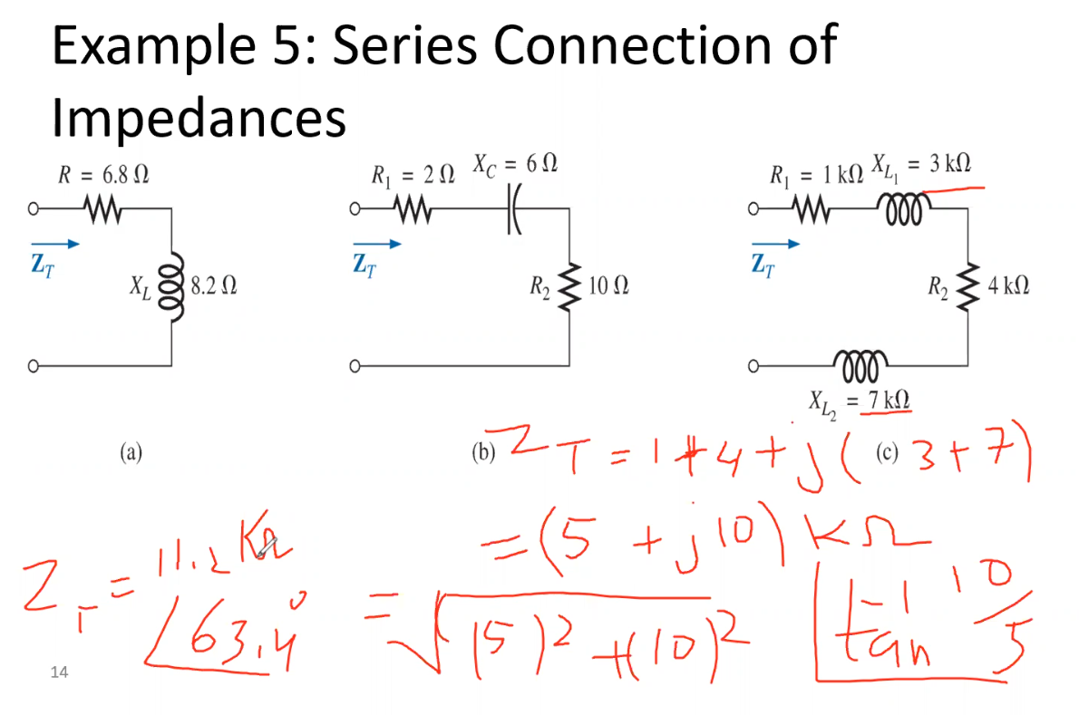

Slide 18
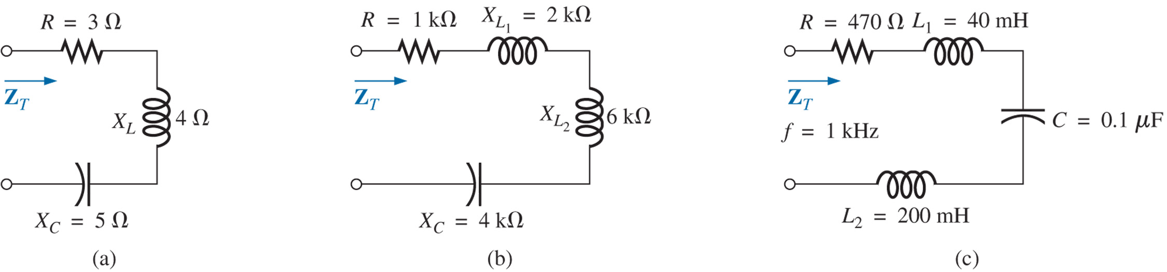
Example 6: Series Connection of Impedances

Slide 19
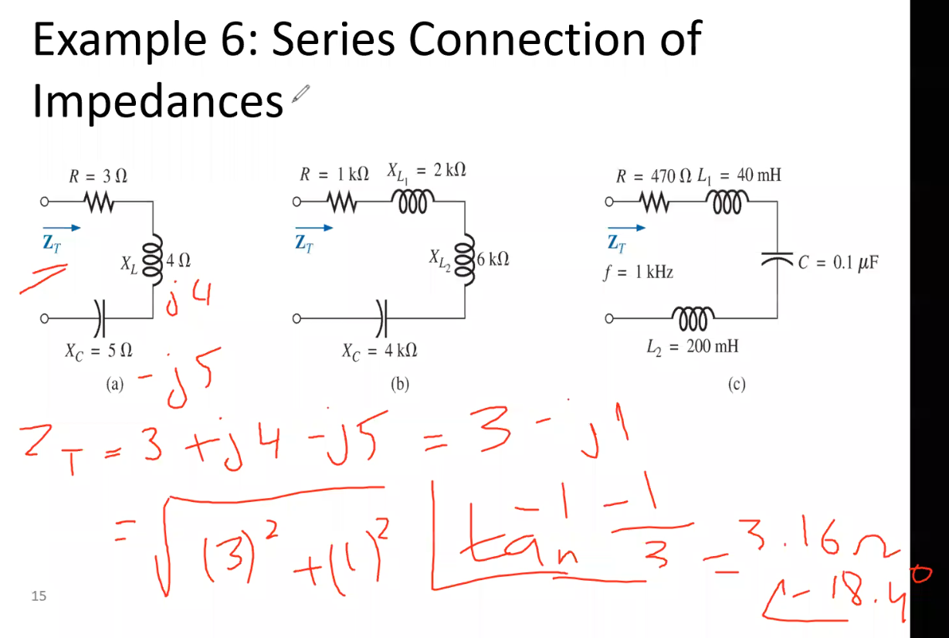

Slide 20
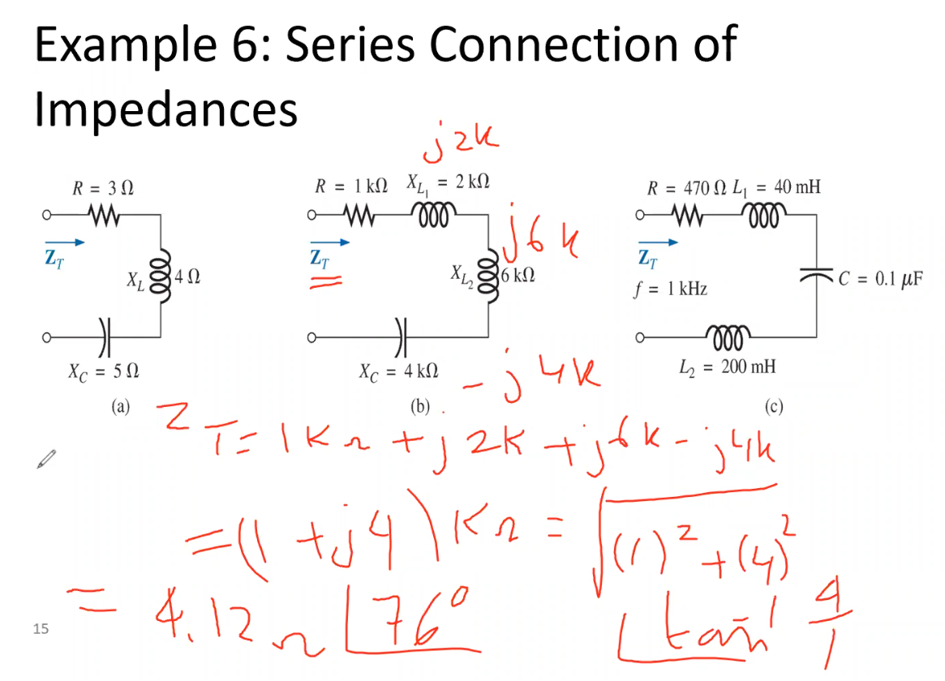

Slide 21
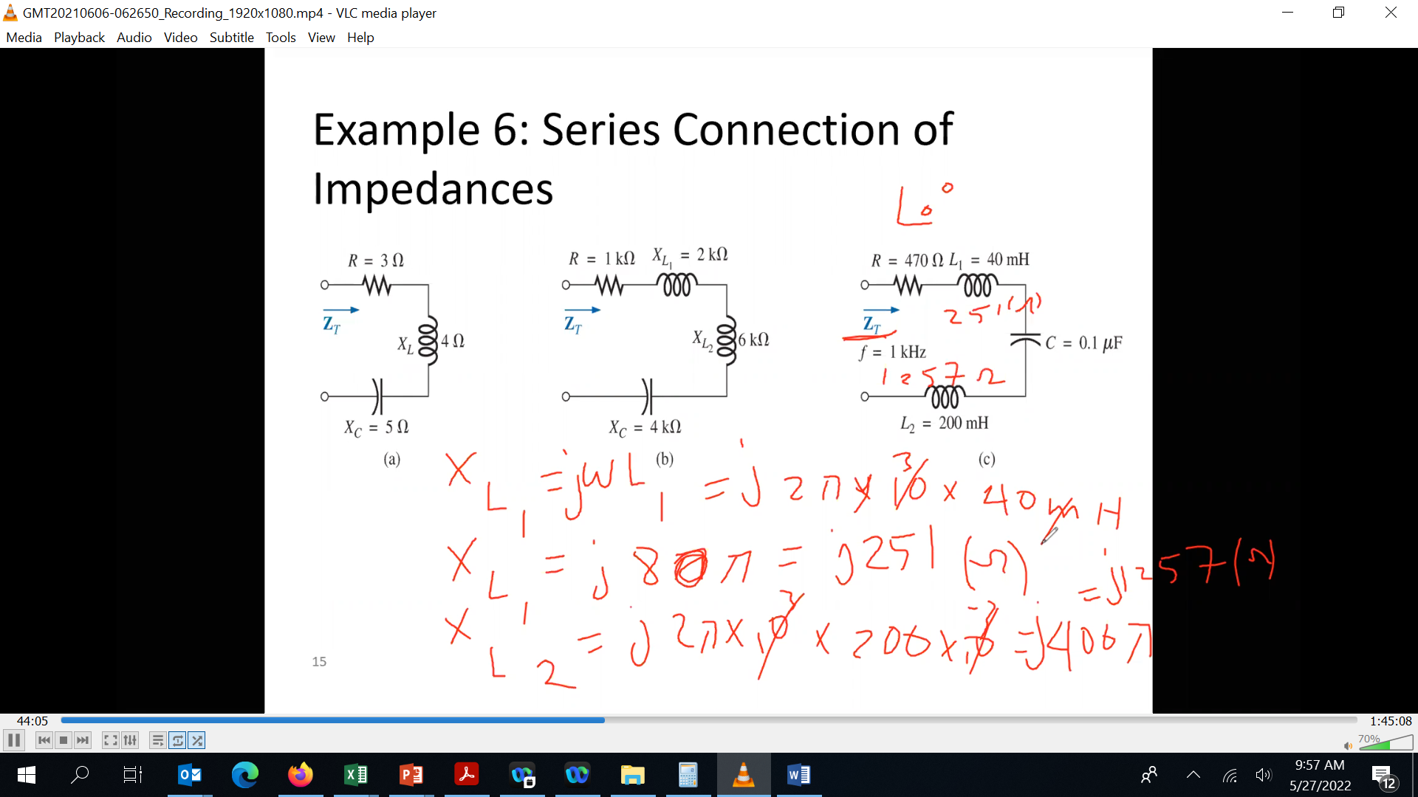
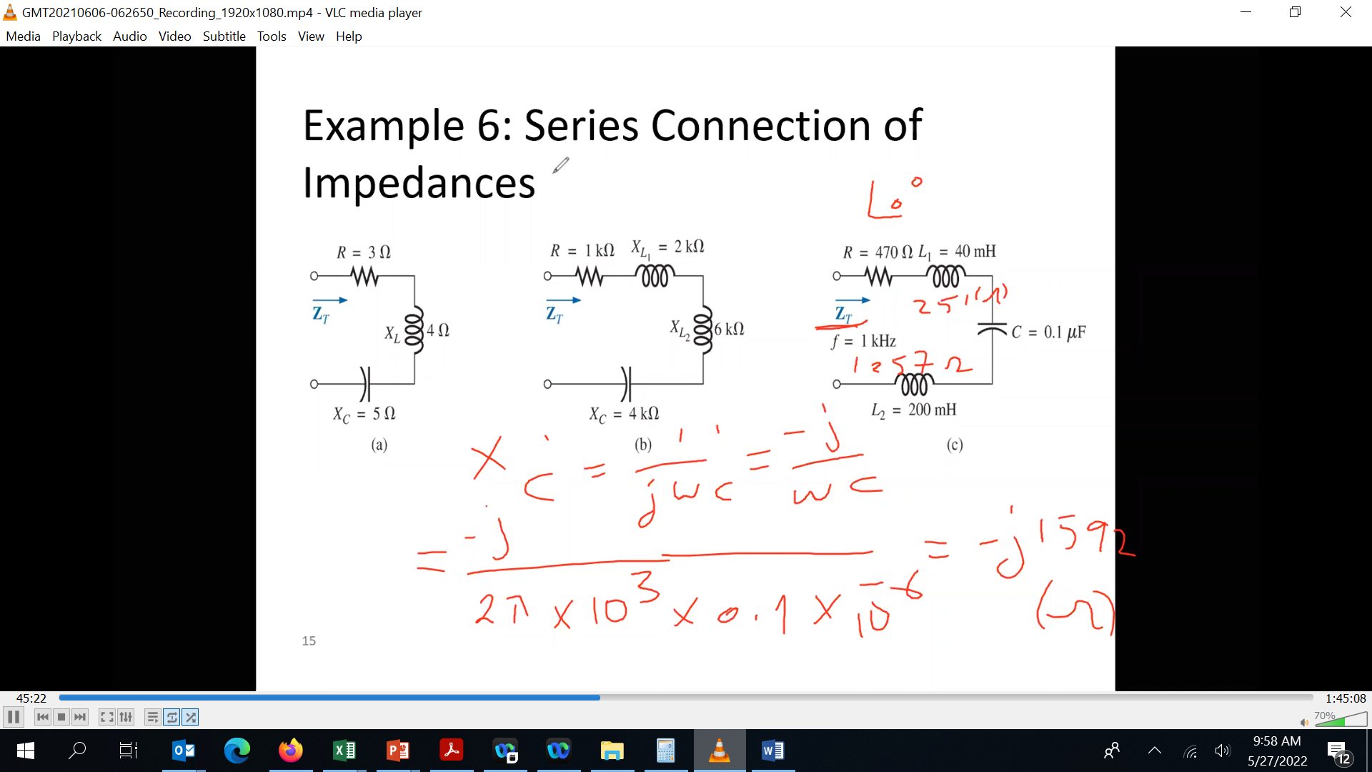
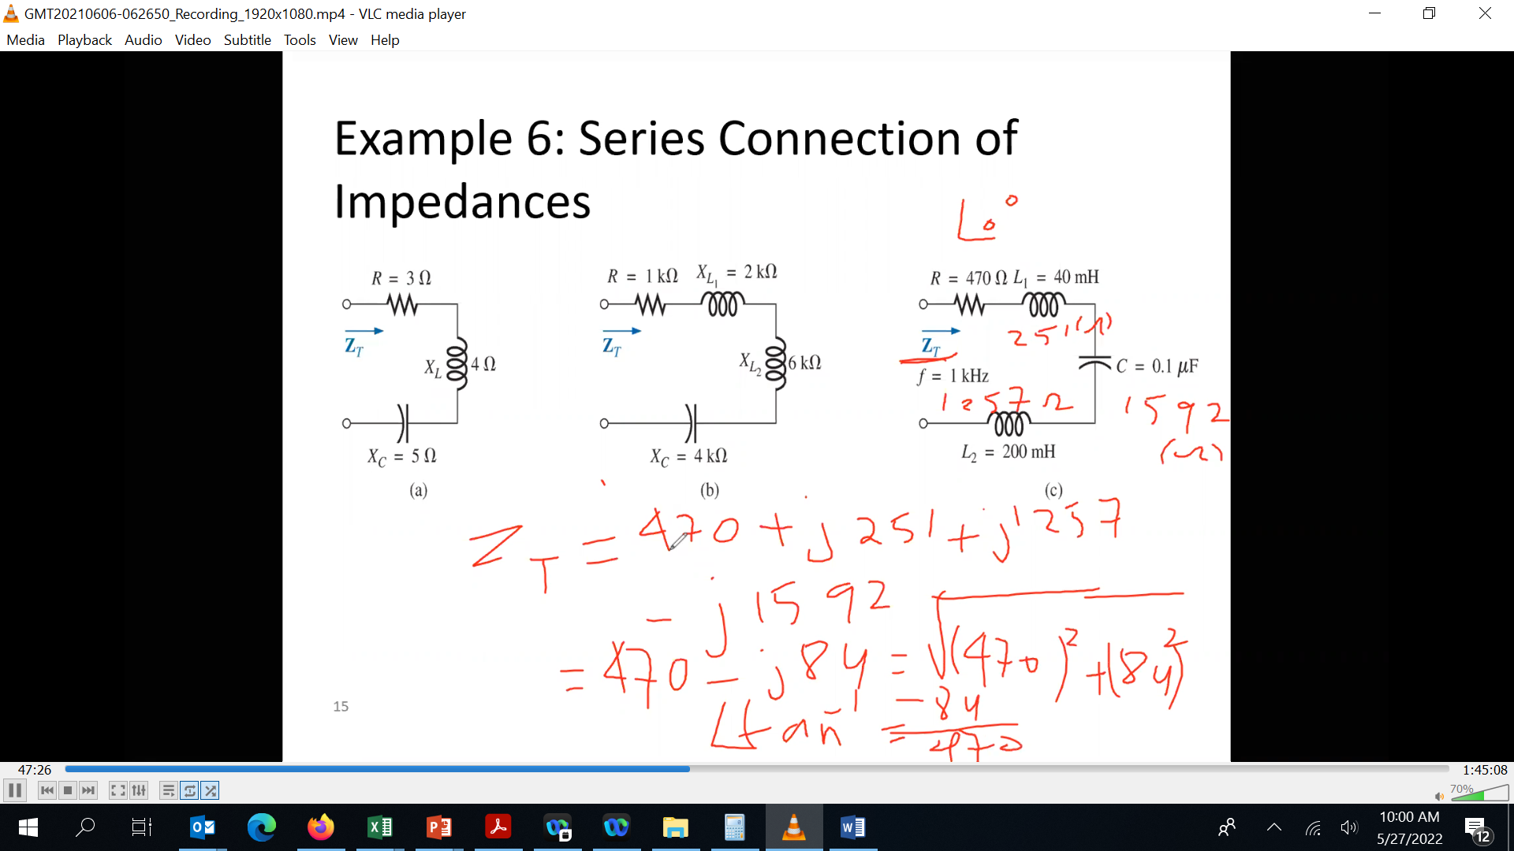





Slide 22
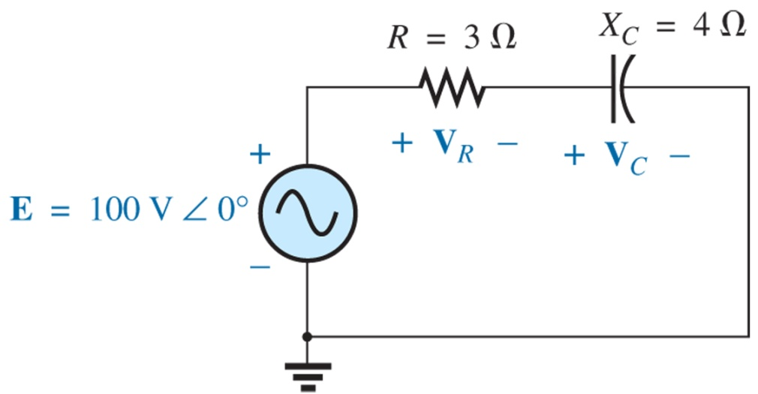





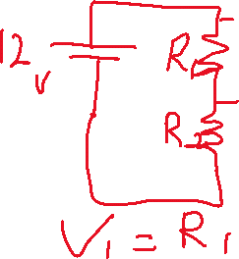

Voltage Divider Rule
Example 15.9,
Using the voltage divider rule find the voltage across each element of the circuit

Slide 23
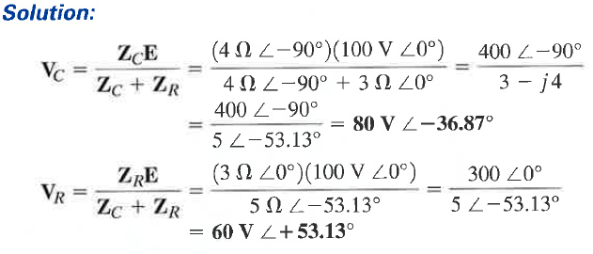
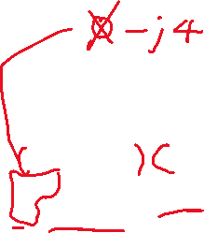

Voltage Divider continued

Slide 24
Voltage Divider Rule
Voltage divider rule states:
V_{x} - voltage across one or more elements connected in series that have a total impedance of Z_{x}
Z_{T} – total impedance of all series connected elements
V_{T} – total voltage across all series connected elements

Slide 25
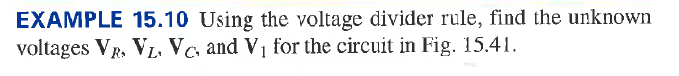
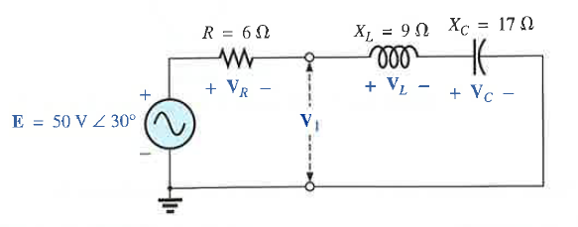







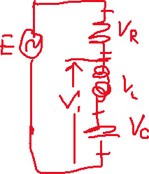







Example 7: Voltage Divider

Slide 26
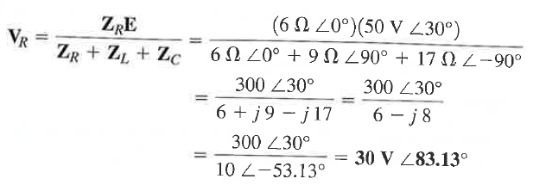
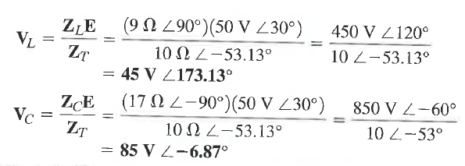

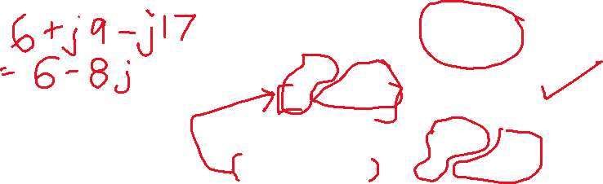
Example 7 continued

Slide 27
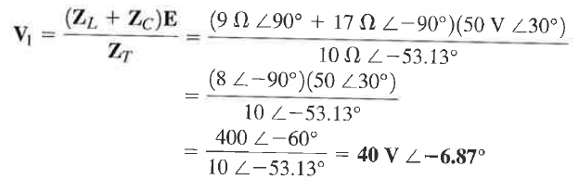
Example 7 Continued

Slide 28
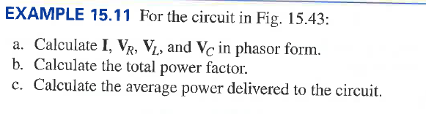
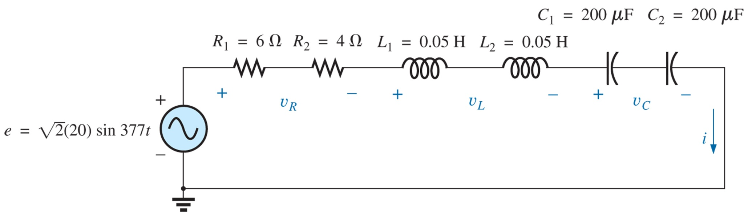
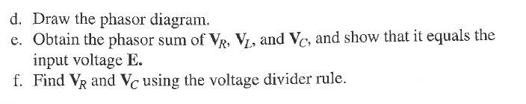
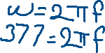
Example 8: Series Connection of Impedances

Slide 29
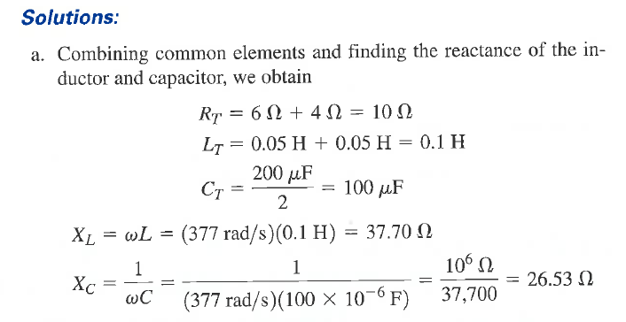
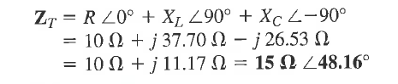


Example 8 continued

Slide 30
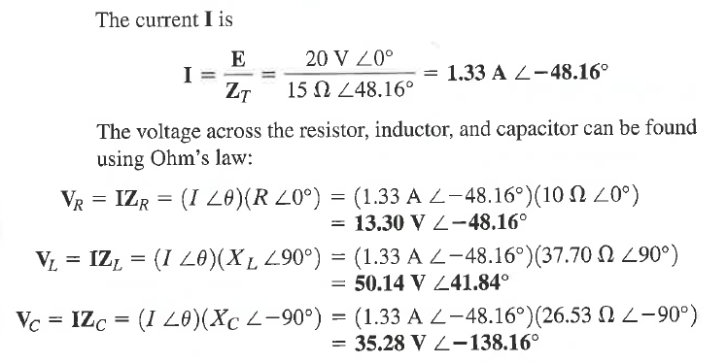


Example 8 Continued

Slide 31

Example 8 Continued

Slide 32

Example 8 Continued

Slide 33


Example 8 Continued
Vc
VL
VL-Vc
VR
VL – Vc + VR
VR is in phase with I

Slide 34

Frequency response of series circuits
The behaviour of a series connected R, L and C circuit will depend on the frequency response of the individual components added together using a phasor approach

Slide 35
Frequency response of series circuits
at low frequencies L is less effective and impedance is governed by R and C
at high frequencies C is less effective and impedance is governed by R and L

Slide 36

Frequency response of a series R-C circuit
at low frequencies X_{C} dominates (X_{C} > R) and at high frequencies its dominance decreases (X_{C} < R)
Fig 15.48, p 655, Bolylestad

Slide 37


Frequency response of a series R-C circuit
Variation of the angle of Z_{T} with frequency
Variation of the magnitude of Z_{T} with frequency

Slide 38

Frequency response of a series R-L circuit
Example 15.12, p 661, Boylestad
Determine the frequency at which R = X_{L}
(c) Find the total impedance for f =100Hz and 40kHz
(d) Plot V_{L} vs frequency
(e) Find the phase angle of Z_{T} at f = 40kHz. Can the circuit be considered inductive? Why?

Slide 39


Frequency response of a series R-L circuit
Example 15.12, p 661, Boylestad…..
At this frequency, the impedance of the inductor
will be equal to the impedance of the resistor

Slide 40


Example Continued

Slide 41

Example Continued

Slide 42






Example Continued

Slide 43



Parallel AC Circuits
In general impedances can be connected in parallel. If Z₁, Z₂ .. Z_{N} are connected in parallel we can write:
Fig 15.58, p 664, Bolylestad

Slide 44



Parallel AC Circuits
$$Z_{L}=jX_{L}=jωL$$
$$Z_{c}=−jX_{c}=\frac{1}{jωC}$$
For a resistance:
For an inductor:
For a capacitor:

Slide 45

Parallel AC Circuits
Example 15.13, p 666, Boylestad
(a) Calculate the input impedance (b) Draw the impedance diagram (c) Find the admittance of each element (d) Determine the input admittance and draw the admittance diagram

Slide 46


Example Continued

Slide 47


Example Continued

Slide 48

Parallel AC Circuits
Example 15.14, p 666, Boylestad
(a) Calculate the input impedance (b) Draw the impedance diagram (c) Find the admittance of each element (d) Determine the input admittance and draw the admittance diagram

Slide 49


Example Continued
4.68{cos(20.56)+jsin(20.56)}
= 4.38 + j1.64

Slide 50


Example Continued
$$Z_{L}=jX_{L}=jωL$$
$$Z_{c}=−jX_{c}=\frac{1}{jωC}$$

Slide 51

Parallel AC Circuits, more examples

Slide 52


Slide 53

Current Divider Rule

Slide 54


Current Divider Rule

Slide 55



Another Example

Slide 56


Frequency separation
Low frequency
Amplifier drives the speakers all connected in parallel through R-L-C circuits
Each speaker is able to reproduce a range of frequencies only, so divert those frequencies to appropriate speaker
Send low frequencies to the woofer and high frequencies to the tweeter and the mid range frequencies to the mid range speaker
Mid range frequency
High frequency

Slide 57

Frequency separation
R_{Amplifier}
Assuming the amplifier to be a voltage source (12V) in series with an internal resistance (8Ω) (commonly known as the output impedance of the amplifier) the voltage that appear across the 8Ω speaker can be found out as the frequency varies in the audible range
R_{Speaker}

Slide 58
Frequency separation
Equations used to calculate the voltage across the speaker employing the voltage divider rule

Slide 59
Frequency separation
Equations implemented in a spreadsheet used to calculate the voltage across speaker

